Slide 1

Driving Decisions: A Data-Driven Guide to Car Buying
Leveraging Insights for Informed Purchases
By: Brett Coulter

Slide 2

Welcome to the Data-Driven Car Buying Guide Presentation!
Objective:
Provide insights and recommendations for making informed car purchase decisions using data analytics.
Dataset:
Utilizing the "Vehicle Sales and Market Trends Dataset“ from Kaggle.com containing comprehensive information on car sales transactions.
Importance:
Understanding market trends, pricing dynamics, and key factors influencing car prices.
Stay tuned to learn how data analysis can empower you in your next car buying journey!

Slide 3

Business Objective
Objective
To provide prospective car buyers with data-driven insights and recommendations to facilitate informed purchasing decisions.
Key Points
Enable car buyers to understand market trends and factors influencing car prices.
Empower buyers with strategies for negotiating prices, identifying good deals, and avoiding common pitfalls in car buying.
Utilize data analysis to offer practical recommendations tailored to the needs of car buyers.
Importance
Enhances transparency and trust by offering evidence-based guidance.
Supports buyers in making informed decisions that align with their preferences and budget.
Promotes a positive car buying experience and reduces the risk of dissatisfaction or financial loss.

Slide 4
Understanding the Dataset
Description
"Vehicle Sales and Market Trends Dataset" contains comprehensive information on vehicle sales transactions.
Key Features
Includes vehicle details, transaction info, Manheim Market Report (MMR) values, condition, and mileage.
Use Cases
Market analysis, predictive modeling, business insights.
Format Tabular (e.g., CSV), over 600,000 recorded sales
Update Frequency Updated to 2015

Slide 5
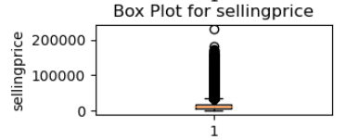
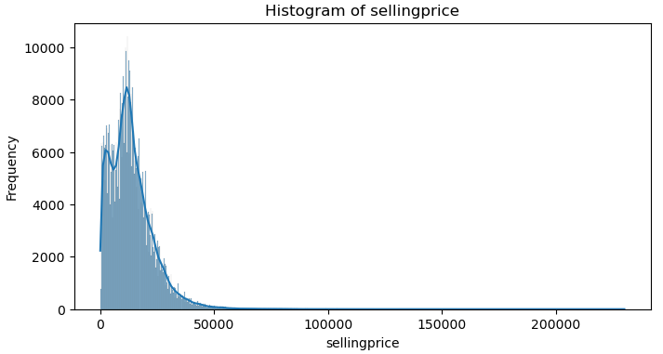
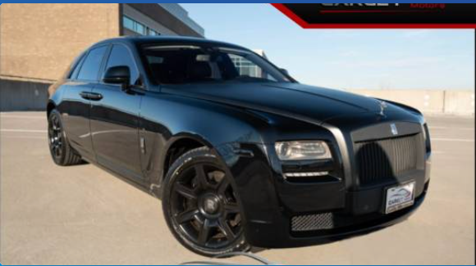
Exploratory Data Analysis (Before Cleaning)
Large Variability due to Luxury Car Sales!
2013 Rolls-Royce Ghost sold for $171,500

Slide 6
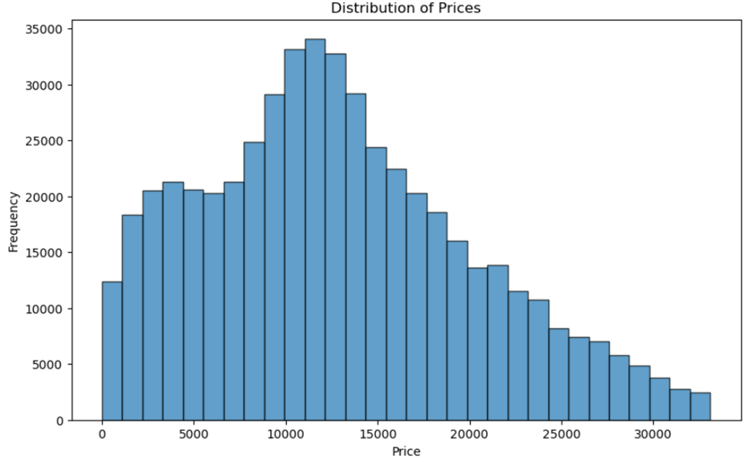
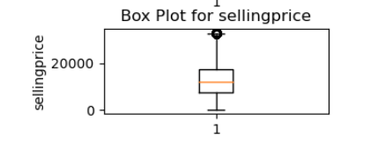
Exploratory Data Analysis (Post Cleaning)
Average Selling Price of $12,861.39
Eliminated outliers by trimming all selling price values by 2 Z-scores

Slide 7
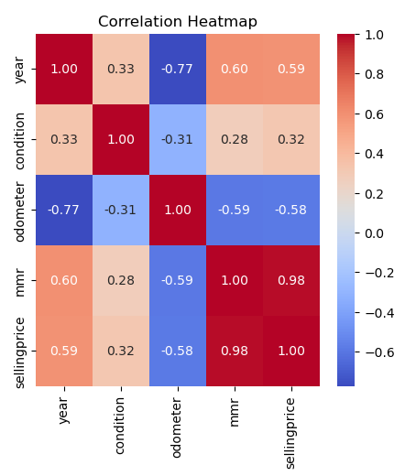
Factors Influencing Car Prices
Correlation Matrix:
The correlation matrix highlights the relationships between different variables and their influence on car prices.
Key Insights:
Year: Shows a positive correlation with selling prices, suggesting that newer vehicles tend to have higher prices.
Condition: Exhibits a moderate positive correlation with selling prices, indicating that well-maintained vehicles command higher prices.
Odometer: Displays a strong negative correlation with selling prices, implying that lower mileage vehicles generally sell for higher prices.
Interpretation:
The year of manufacture, condition, odometer reading, and MMR values are significant factors influencing car prices.
Newer vehicles in better condition with lower mileage and higher MMR values generally command higher selling prices in the market.
Recommendations:
Buyers should consider these factors when evaluating the value of a vehicle and negotiating prices.

Slide 8
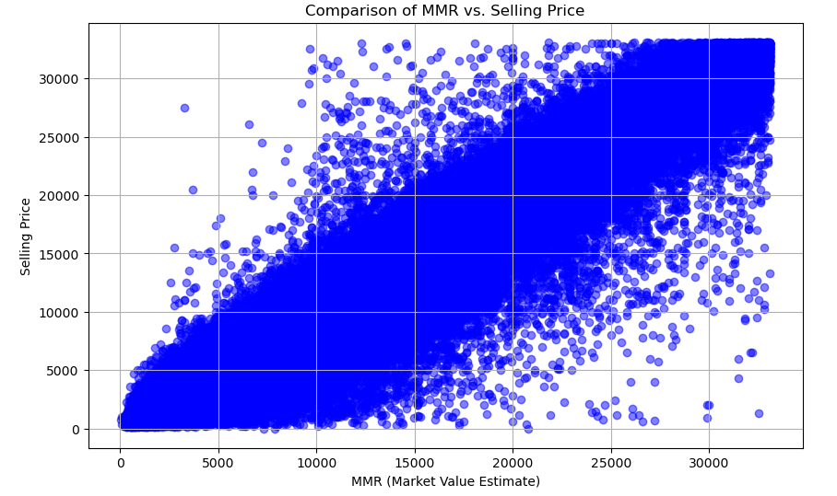
MMR vs. Selling Price
Visualization: Scatter plot comparing Manheim Market Report (MMR) values against selling prices of vehicles.
Strong Correlation: Notice the strong positive correlation between MMR values and selling prices, indicating that as MMR values increase, selling prices tend to increase as well.
Insightful Trend: The upward trend in the scatter plot suggests that MMR values are a reliable indicator of the market value of vehicles, influencing their selling prices accordingly.
Implications: This correlation underscores the importance of considering MMR values when evaluating the fair market value of a vehicle, providing valuable insights for both buyers and sellers in the automotive market.

Slide 9
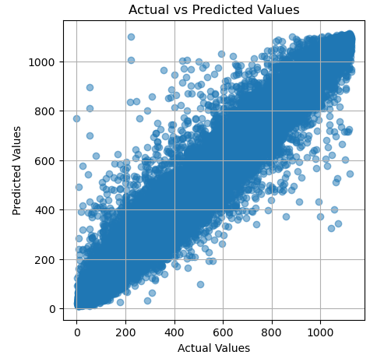
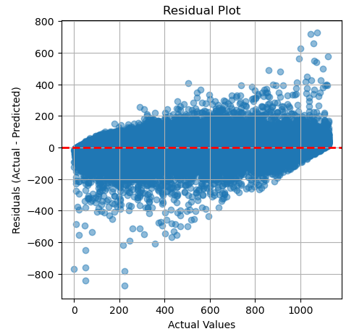
Predictive Modeling for Price Estimation
Model Selection:
Utilized Random Forest Regression, a robust ensemble learning technique, for predictive modeling due to its ability to handle non-linearity and interactions among features effectively.
Model Performance:
Validation Mean Squared Error (MSE): 2488.97
Mean Squared Error (MSE) on Test Data: 2405.95
R-squared (R2) on Test Data: 0.966
Mean Absolute Error (MAE) on Test Data: 32.97
Insights:
The Random Forest Regression model demonstrates strong predictive performance, as evidenced by high R-squared and low MSE and MAE values.
The model effectively captures the underlying patterns in the data and provides accurate predictions of car prices.

Slide 10

Role of the Random Forest Regressor (RFR) Model in Decision Making
Purpose: The Random Forest Regressor (RFR) model was employed to predict vehicle prices based on various attributes, aiding in decision-making during the car purchasing process.
Predictive Power: Leveraging machine learning techniques, the RFR model accurately estimates vehicle prices by considering factors such as year, condition, odometer readings, and Manheim Market Report (MMR) values.
Guiding Decisions: By utilizing the RFR model predictions, prospective car buyers can make informed decisions regarding the fair market value of vehicles they are interested in purchasing.
Risk Mitigation: The RFR model helps mitigate the risk of overpaying for a vehicle by providing a reliable estimate of its value, enabling buyers to negotiate prices more effectively and avoid potential financial pitfalls.

Slide 11

Guidelines for Car Buyers
Key Insights:
Factors influencing car prices include manufacturing year, vehicle condition, odometer reading, and market values.
Newer vehicles with lower mileage and better condition generally command higher prices.
Market trends indicate a strong correlation between Manheim Market Report (MMR) values and selling prices.
Recommendations:
Prioritize vehicles with newer manufacturing years and lower mileage for better value.
Use MMR values as a reference point to assess fair prices relative to vehicle condition.
Leverage predictive models for accurate price estimates and effective negotiation strategies.

Slide 12
Conclusion
Project Overview
Objective: To analyze vehicle sales data and provide actionable insights for car buyers.
Methodology: Utilized exploratory data analysis, correlation analysis, predictive modeling, and visualization techniques.
Practical Insights and Recommendations
Key findings: Factors such as manufacturing year, mileage, and market values significantly influence car prices.
Recommendations: Prioritize newer vehicles with lower mileage, leverage market trends, and use predictive models for accurate price estimates.
Empowering Car Buyers
The data-driven guide equips car buyers with valuable insights and negotiation strategies for informed decision-making.
Encouragement to utilize the provided recommendations and guidelines to navigate the car buying process confidently.
Takeaway Message
Make use of the data-driven approach to find the right vehicle at the right price, ensuring a satisfying and rewarding car buying experience.

Slide 13

Thank you!

